Slide 1
Lecture 4
Agile
Muhammad Qasim
BSCS (Software Engineering-I) SZABIST-Islamabad

Slide 2
Software Process Models
Waterfall
Iterative
Incremental
V Model
Prototype Model
Spiral
Agile
BSCS (Software Engineering-I) SZABIST-Islamabad

Slide 3
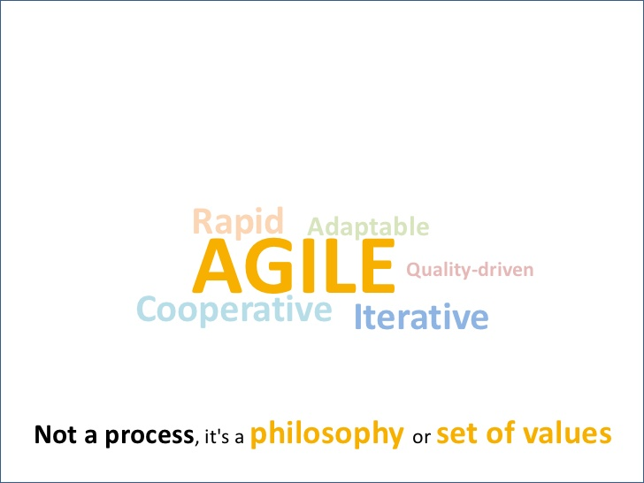
What is Agile
BSCS (Software Engineering-I) SZABIST-Islamabad

Slide 4
Agile
Agile SDLC model is a combination of iterative and incremental process models with focus on process adaptability and customer satisfaction by rapid delivery of working software product.
Agile Methods break the product into small incremental builds. These builds are provided in iterations.
Each iteration typically lasts from about one to three weeks.
Every iteration involves cross functional teams working. simultaneously on various areas like −
  Planning
  Requirements Analysis
  Design
  Coding
  Unit Testing and
  Acceptance Testing.
BSCS (Software Engineering-I) SZABIST-Islamabad

Slide 5
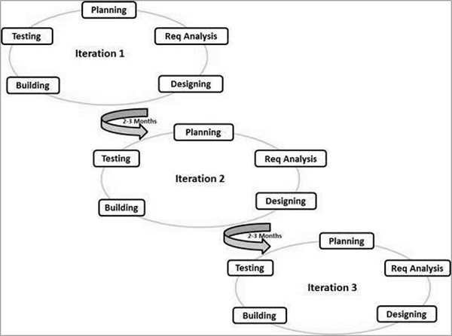
Agile
BSCS (Software Engineering-I) SZABIST-Islamabad

Slide 6
4 Values of Agile
4 values of Agile Manifesto is comprised of:
Individuals and interactions over processes and tools
Working software over comprehensive documentation
Customer collaboration over contract negotiation
Responding to change over following a plan
BSCS (Software Engineering-I) SZABIST-Islamabad

Slide 7
Manifesto for Agile Software Development
The twelve principles of agile Manifesto include:
Customer satisfaction through early and continuous software delivery – Customers are happier when they receive working software at regular intervals, rather than waiting extended periods of time between releases.
Accommodate changing requirements throughout the development process – The ability to avoid delays when a requirement or feature request changes.
Frequent delivery of working software – Scrum accommodates this principle since the team operates in software sprints or iterations that ensure regular delivery of working software.
Collaboration between the business stakeholders and developers throughout the project – Better decisions are made when the business and technical team are aligned.
Support, trust, and motivate the people involved – Motivated teams are more likely to deliver their best work than unhappy teams.
Enable face-to-face interactions – Communication is more successful when development teams are co-located.
BSCS (Software Engineering-I) SZABIST-Islamabad

Slide 8
Manifesto for Agile Software Development
The twelve principles of agile Manifesto include:
Working software is the primary measure of progress – Delivering functional software to the customer is the ultimate factor that measures progress.
Agile processes to support a consistent development pace – Teams establish a repeatable and maintainable speed at which they can deliver working software, and they repeat it with each release.
Attention to technical detail and design enhances agility – The right skills and good design ensures the team can maintain the pace, constantly improve the product, and sustain change.
Simplicity – Develop just enough to get the job done for right now.
Self-organizing teams encourage great architectures, requirements, and designs – Skilled and motivated team members who have decision-making power, take ownership, communicate regularly with other team members, and share ideas that deliver quality products.
Regular reflections on how to become more effective – Self-improvement, process improvement, advancing skills, and techniques help team members work more efficiently.
BSCS (Software Engineering-I) SZABIST-Islamabad

Slide 9
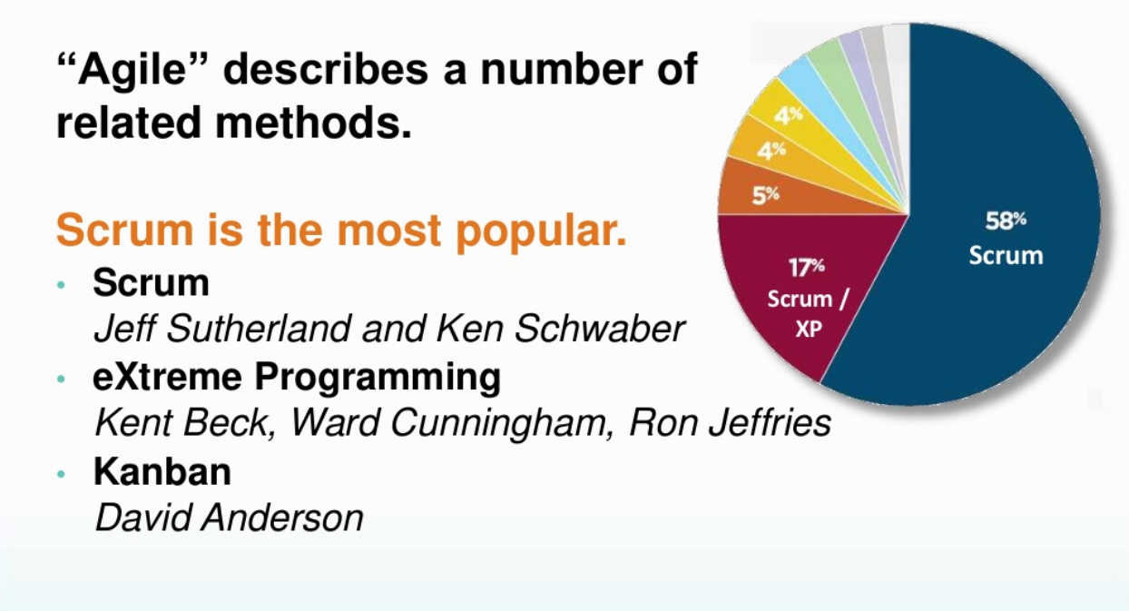
The Agile Landscape
BSCS (Software Engineering-I) SZABIST-Islamabad

Slide 10
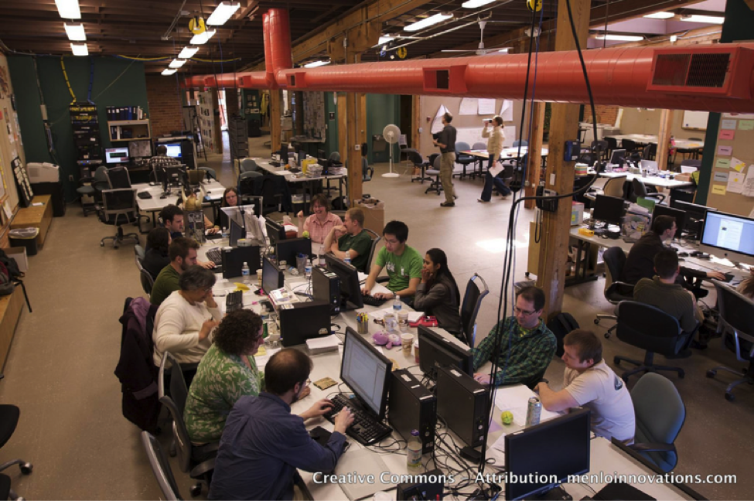
Agile Team
BSCS (Software Engineering-I) SZABIST-Islamabad

Slide 11
Agile Terminologies
Release:
A release is a major milestone that represents an internal or external delivery of working, tested version of the product/system
Release Planning (S1)
The purpose of release planning is to create a plan to deliver an increment to the product. It is done after every 2 to 3 months.
BSCS (Software Engineering-I) SZABIST-Islamabad

Slide 12
Agile Terminologies
Product Backlog:
An ordered list of the work to be done in order to create, maintain and sustain a product.
Backlog Grooming Session (S2)
It is an ongoing process in which the product manager or the customer manages the product backlog by getting feedback from agile teams. This process involves prioritizing the portfolio items, breaking them in smaller items, planning them for future iterations, creating new stories, updating acceptance criteria or elaborating acceptance criteria in details.
BSCS (Software Engineering-I) SZABIST-Islamabad

Slide 13
Agile Terminologies
Iteration
A period (from 1 week to 2 months in duration) during which the Agile development team produces an increment of completed software. All system lifecycle phases (requirements, design, code, and test) must be completed during the iteration and then demonstrated for the iteration to be accepted as successfully completed.
Iteration Planning (S3):
It is a meeting held after the release planning meeting. In this meeting we decide which user stories we are going to build in coming iteration.
BSCS (Software Engineering-I) SZABIST-Islamabad

Slide 14
Agile Terminologies
Iteration Backlog
List of selected items chosen from Product backlog to be used in next release.
Capacity
It is the amount of work a team can take to complete in one iteration.
BSCS (Software Engineering-I) SZABIST-Islamabad

Slide 15
Agile Terminologies
Product Owner
The product owner is a member of the Agile delivery team, responsible to collect and rank business requirements in the product backlog. A product owner communicates what is to be done in a release/iteration. He/she sets the commitments and is responsible to protect team from any change in requirements during an iteration.
BSCS (Software Engineering-I) SZABIST-Islamabad

Slide 16
Agile Terminologies
Acceptance Criteria
It is the conditions set by the product owner or the customer in order to accept a feature to be valid and adhering to their requirements.
BSCS (Software Engineering-I) SZABIST-Islamabad

Slide 17
Agile Terminologies
Daily Stan-up (S4)
A daily stand-up is a daily status meeting among all team members and it is held roughly for 15 minutes.
Every member has to answer three important questions.
    What I did yesterday?
    What I'll do today?
    Any impediment I am facing.../ I am blocked due to...
BSCS (Software Engineering-I) SZABIST-Islamabad

Slide 18
Agile Terminologies
Epic
A very large user story that is eventually broken down into smaller stories. Epics are often used as placeholders for new ideas and related stories to be developed in subsequent sprints.
User Story
A user story is a requirement which is formulated in a few sentences in everyday language of an user and it should be completed within an iteration.
BSCS (Software Engineering-I) SZABIST-Islamabad

Slide 19
Agile Terminologies
Sprint Review (S5): Time-boxed event of 4 hours, or less, to conclude the development work of a Sprint. It serves for the Scrum Team and the stakeholders to inspect the Increment of product resulting from the Sprint, assess the impact of the work performed on overall progress and update the Product backlog in order to maximize the value of the next period.
Sprint Retrospective (S6): ”Time-boxed event of 3 hours, or less, to end a Sprint. It serves for the Scrum Team to inspect the past Sprint and plan for improvements to be enacted during the next Sprint”.
BSCS (Software Engineering-I) SZABIST-Islamabad

